Slide 1
Deep Learning Resume
„Noțiuni introductive pentru proiect”

Slide 2
Machine learning algorithms typically search for the optimal representation of data using a feedback signal in the form of an objective function.
However, most machine learning algorithms only have the ability to use one or two layers of data transformation to learn the output representation.
We call these shallow models since they only use 1–2 representations of the feature space. As data sets continue to grow in the dimensions of the feature space, finding the optimal output representation with a shallow model is not always possible.

Slide 3
Deep learning provides a multi-layer approach to learn data representations, typically performed with a multi-layer neural network.
Like other machine learning algorithms, deep neural networks (DNN) perform learning by mapping features to targets through a process of simple data transformations and feedback signals; however, DNNs place an emphasis on learning successive layers of meaningful representations. Although an intimidating subject, the overarching concept is rather simple and has proven highly successful across a wide range of problems (e.g., image classification, speech recognition, autonomous driving). This presentation will teach you the fundamentals of building a simple feedforward DNN, which is the foundation for the more advanced deep learning models.

Slide 4


Slide 5
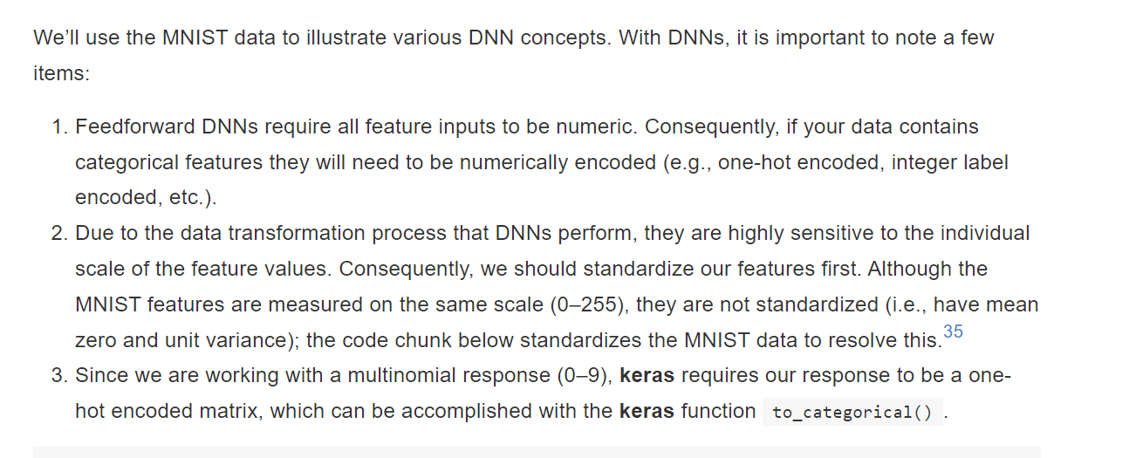

Slide 6
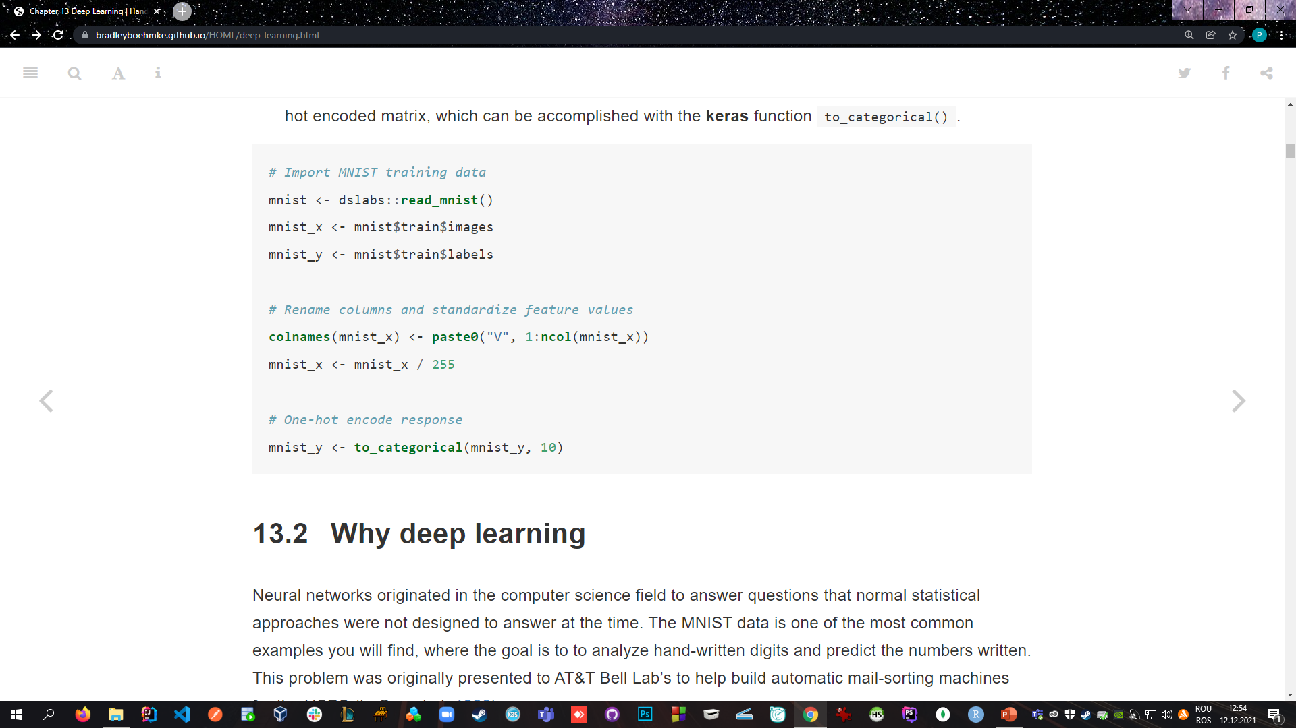

Slide 7
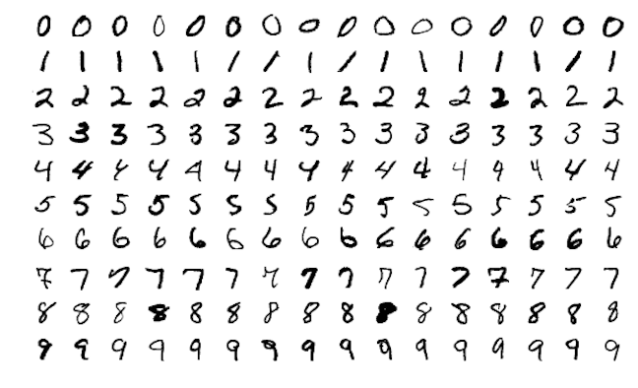
Why deep learning
Neural networks originated in the computer science field to answer questions that normal statistical approaches were not designed to answer at the time.
The MNIST data is one of
the most common examples you
will find, where the goal is to to
analyze hand-written digits and
predict the numbers written.

Slide 8
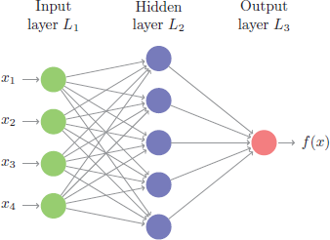
This problem is quite unique because many different features of the data can be represented.
As humans, we look at these numbers and consider features such as angles, edges, thickness, completeness of circles, etc. We interpret these different representations of the features and combine them to recognize the digit.
In essence, neural networks perform the same task
in a far simpler manner than our brains. At their most
basic levels, neural networks have three layers:
- input layer,
- hidden layer,
- output layer
The input layer consists of all of the original input features. The majority of the learning takes place in the hidden layer, and the output layer outputs the final predictions.

Slide 9
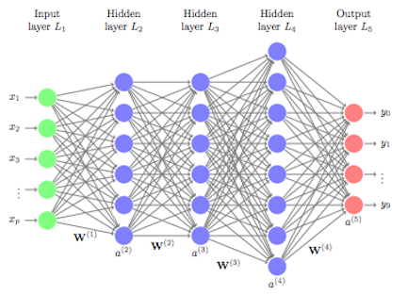
Although simple on the surface, the computations being performed inside a network require lots of data to learn and are computationally intense rendering them impractical to use in the earlier days.
However, over the past several decades, advancements
in computer hardware (off the shelf CPUs became faster and
GPUs were created) made the computations more practical,
the growth in data collection made them more relevant,
and advancements in the underlying algorithms made
the depth (number of hidden layers) of neural nets less of a
constraint.
These advancements have resulted in the ability to run very deep and highly parameterized neural networks (i.e., DNNs).

Slide 10
Such DNNs allow for very complex representations of data to be modeled, which has opened the door to analyzing high-dimensional data (e.g., images, videos, and sound bytes).
In some machine learning approaches, features of the data need to be defined prior to modeling (e.g., ordinary linear regression). One can only imagine trying to create the features for the digit recognition problem above.
However, with DNNs, the hidden layers provide the means to auto-identify useful features. A simple way to think of this is to go back to our digit recognition problem. The first hidden layer may learn about the angles of the line, the next hidden layer may learn about the thickness of the lines, the next may learn the location and completeness of the circles, etc.
Aggregating these different attributes together by linking the layers allows the model to accurately predict what digit each image represents.
This is the reason that DNNs are so popular for very complex problems where feature engineering is important, but rather difficult to do by hand (e.g., facial recognition).
However, at their core, DNNs perform successive non-linear transformations across each layer, allowing DNNs to model very complex and non-linear relationships. This can make DNNs suitable machine learning approaches for traditional regression and classification problems as well.
But it is important to keep in mind that deep learning thrives when dimensions of your data are sufficiently large (e.g., very large training sets). As the number of observations (n) and feature inputs (p) decrease, shallow machine learning approaches tend to perform just as well, if not better, and are more efficient.

Slide 11
Feedforward DNNs

Slide 12
Multiple DNN architectures exist and, as interest and research in this area increases, the field will
continue to flourish.
Convolutional neural networks (CNNs) have widespread applications in image and video recognition.
Recurrent neural networks (RNNs) are often used with speech recognition .
Long short-term memory neural networks (LSTMs) are advancing automated robotics and machine translation.
However, fundamental to all these methods is the feedforward DNN (aka multi layer perceptron). Feedforward DNNs are densely connected layers where inputs influence each successive layer which then influences the final output layer.

Slide 13
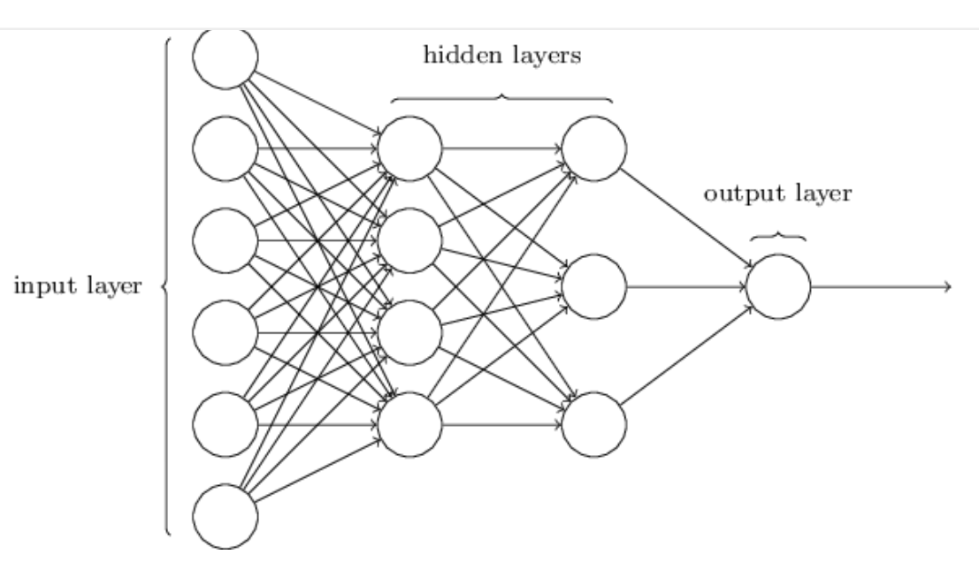
Multiple DNN architectures exist and, as interest and research in this area increases, the field will
continue to flourish.
Convolutional neural networks (CNNs) have widespread applications in image and video recognition.
Recurrent neural networks (RNNs) are often used with speech recognition .
Long short-term memory neural networks (LSTMs) are advancing automated robotics and machine translation.
However, fundamental to all these methods is
the feedforward DNN (aka multi layer perceptron).
Feedforward DNNs are densely connected
layers where inputs influence each successive
layer which then influences the final output layer.

Slide 14


Slide 15
Network architecture

Slide 16
Network architecture (1) layers and nodes

Slide 17
The layers and nodes are the building blocks of our DNN and they decide how complex the network will be. Layers are considered dense (fully connected) when all the nodes in each successive layer are connected. Consequently, the more layers and nodes you add the more opportunities for new features to be learned.
Beyond the input layer, which is just our original predictor variables, there are two main types of layers to consider: hidden layers and an output layer.
Output layers
Hidden layers
There is no well-defined approach for selecting the number of hidden layers and nodes.
These are the first of many hyperparameters to tune. With regular tabular data, 2–5 hidden layers are often sufficient but your best bet is to err on the side of more layers rather than fewer.
The number of nodes you incorporate in these hidden layers is largely determined by the number of features in your data. Often, the number of nodes in each layer is equal to or less than the number of features but this is not a hard requirement. It is important to note that the number of hidden layers and nodes in your network can affect its computational complexity (e.g., training time).
When dealing with many features and, therefore, many nodes, training deep models with many hidden layers can be computationally more efficient than training a single layer network with the same number of high volume nodes.
Consequently, the goal is to find the simplest model with optimal performance.
The choice of output layer is driven by the modeling task.
For regression problems, your output layer will contain one node that outputs the final predicted value.
Classification problems are different. If you are predicting a binary output (e.g., True/False, Win/Loss), your output layer will still contain only one node and that node will predict the probability of success (however you define success). However, if you are predicting a multinomial output, the output layer will contain the same number of nodes as the number of classes being predicted. For example, in our MNIST data, we are predicting 10 classes (0–9); therefore, the output layer will have 10 nodes and the output would provide the probability of each class.

Slide 18
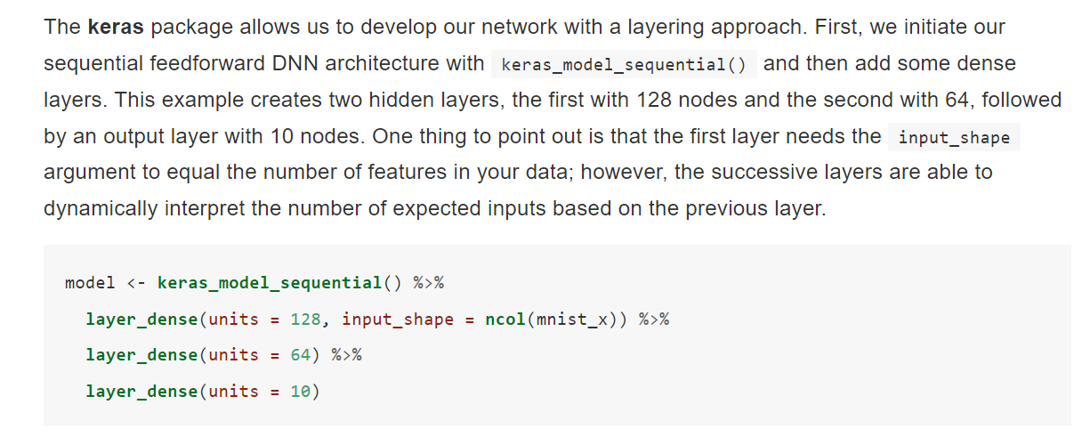
ImplementareA

Slide 19
SFÂRȘIT...

